Slide 1
LOCKING MECHANISMS
CHARVI JAIN
RA2111047010113

Slide 2
-Table of Contents-
Introduction
Types of Locks
Concurrency Protocols
Conclusion

Slide 3
-Introduction-
Locking mechanism is a way to ensure that multiple users can access the same data simultaneously without compromising its integrity. It provides simultaneous access to data while preventing multiple users from modifying it at the same time.
Locks are placed on data items by the DBMS to prevent other users from modifying or accessing that data until the lock is released. By doing so, the locking mechanism provides simultaneous access to data while preserving its integrity.

Slide 4
Types of Locks
Shared Locks
Exclusive Locks

Slide 5
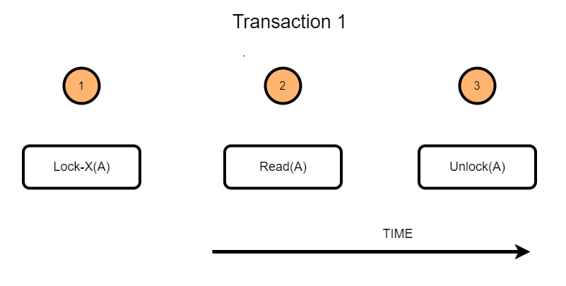
-Shared Locks-
A shared lock, also known as a read lock, is solely used to read data objects. Read integrity is supported via shared locks.
Shared Locks, which are often denoted as lock-S(), is defined as locks that provide Read-Only access to the information associated with them. Whenever a shared lock is used on a database, it can be read by several users, but these users who are reading the information or the data items will not have permission to edit it or make any changes to the data items.
Shared locks can also be used to prevent records from being updated.

Slide 6
-Example-
Shared Locks
Suppose a company has a database that stores information about its employees. An HR manager wants to generate a report on all employees who work in a specific department. They execute a SQL query that reads from the "Employees" table:
SELECT * FROM Employees WHERE Department = 'Marketing’;
After the query is executed a shared lock is placed on the "Employees" table to ensure that no other transactions can modify the table while the query is running. However, other transactions can still read from the table by acquiring their own shared locks.

Slide 7
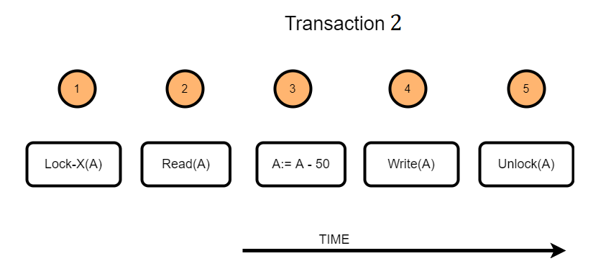
-Exclusive Locks-
The other name for an exclusive lock is write lock.
Exclusive Lock allows the data item to be read as well as written.
This is a single-use mode that cannot be applied to the same data item more than once. The user must use the lock-x command to achieve X-lock. Transactions can unlock the data item after the 'write' phase is complete.
At any given time, the exclusive locks can only be owned by one transaction.

Slide 8
-Example-
Exclusive Locks
Suppose another HR manager wants to update the job title of an employee in the Marketing department. They execute a SQL query that updates the "Employees" table:
UPDATE Employees SET JobTitle = 'Senior Marketing Specialist' WHERE EmployeeID = 12345;
An exclusive lock is placed on the "Employees" table when an update statement is executed to prevent simultaneous modifications and ensure the transaction's completion before allowing other queries.

Slide 9
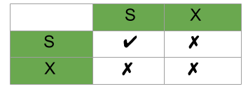
-Compatibility matrix for locks-
The graphs show that if two transactions only read the same data object they do not conflict, but if one transaction writes a data object and another either reads or writes the same data object, then they dispute with each other.

Slide 10
-Conclusion-
Efficient locking is a technique used in database management systems to ensure data consistency and prevent data corruption. By using atomic and isolated transactions, multiple users can access the database simultaneously without interfering with each other's operations. This improves performance and prevents conflicts that can lead to data inconsistencies.

